Slide 1
Lecture 15: The dynamics of animal movements

Slide 2
The organization of behavior
“Locomotion and manipulation are controlled not by the brain but by information. Control lies in the animal-environment system… The rules that govern behavior are not like …decisions made by a commander; behavior is regular without being regulated. The question is how this can be.”
-- J. J. Gibson, 1979
Cognitive solution: in the brain/mind… centralized control (homunculus)… requires prior knowledge
Behaviorist solution: in the environment (external control)… prior order in environment, reinforcement
Ecological solution: in the agent-environment system (emergent control)
Embedded, embodied: exploit physical, biomechanical, informational regularities as a means of ordering behavior
Self-organization: behavior emerges as a stable solution of the system’s dynamics

Slide 3
A classic example of control and coordination
Parsimonious and efficient!

Slide 4
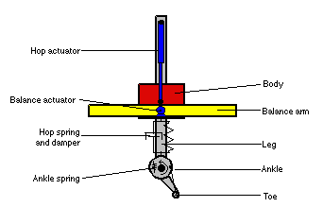
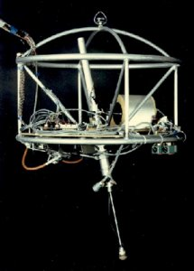
Raibert’s hopping robot (1986)
One-legged hopping robot
Great balance, great stability
No central computational controller (no “brain”)
Uses feedback (sensory-motion link)
Purely dynamical
Extremely animal-like movement
https://www.youtube.com/watch?v=moENDzu_rS0

Slide 5
Raibert on movement control
Build robots by learning human movement behaviors
Design robots and test models to gain knowledge on human behaviors
The control of locomotion is based on simple and efficient dynamical models:
the dynamics of hopping = the dynamics of bouncing ball
https://www.youtube.com/watch?v=K92tohX_ZV4
https://www.youtube.com/watch?v=lxU-SjAO_jM

Slide 6
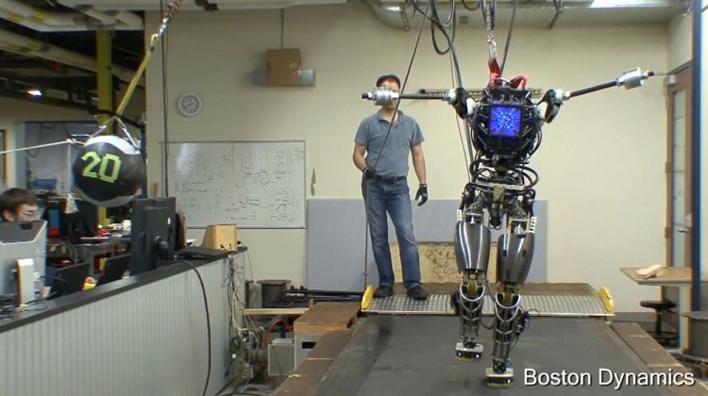
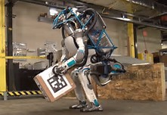
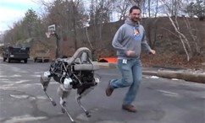
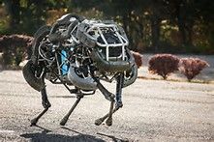
The infallible robots
Videos on contemporary robots

Slide 7
Movement of robots evolves from the interaction between the brain, body and environment.
Body – environment → physical constraints, dynamics
Brain → control posture, maintain propulsion etc.. (the brain’s role is not to come up with a movement plan, execute some algorithm or represent the world)

Slide 8
Human walking and running

Slide 9
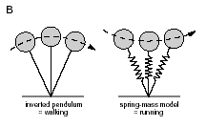
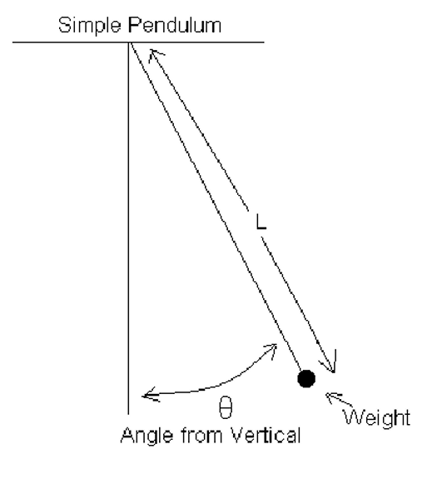
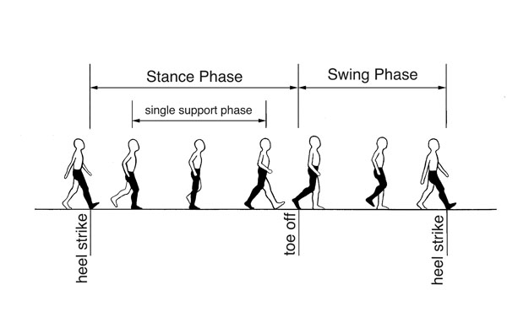
The dynamics of human walking
Dynamics = inverted pendulum
Dynamics = pendulum

Slide 10
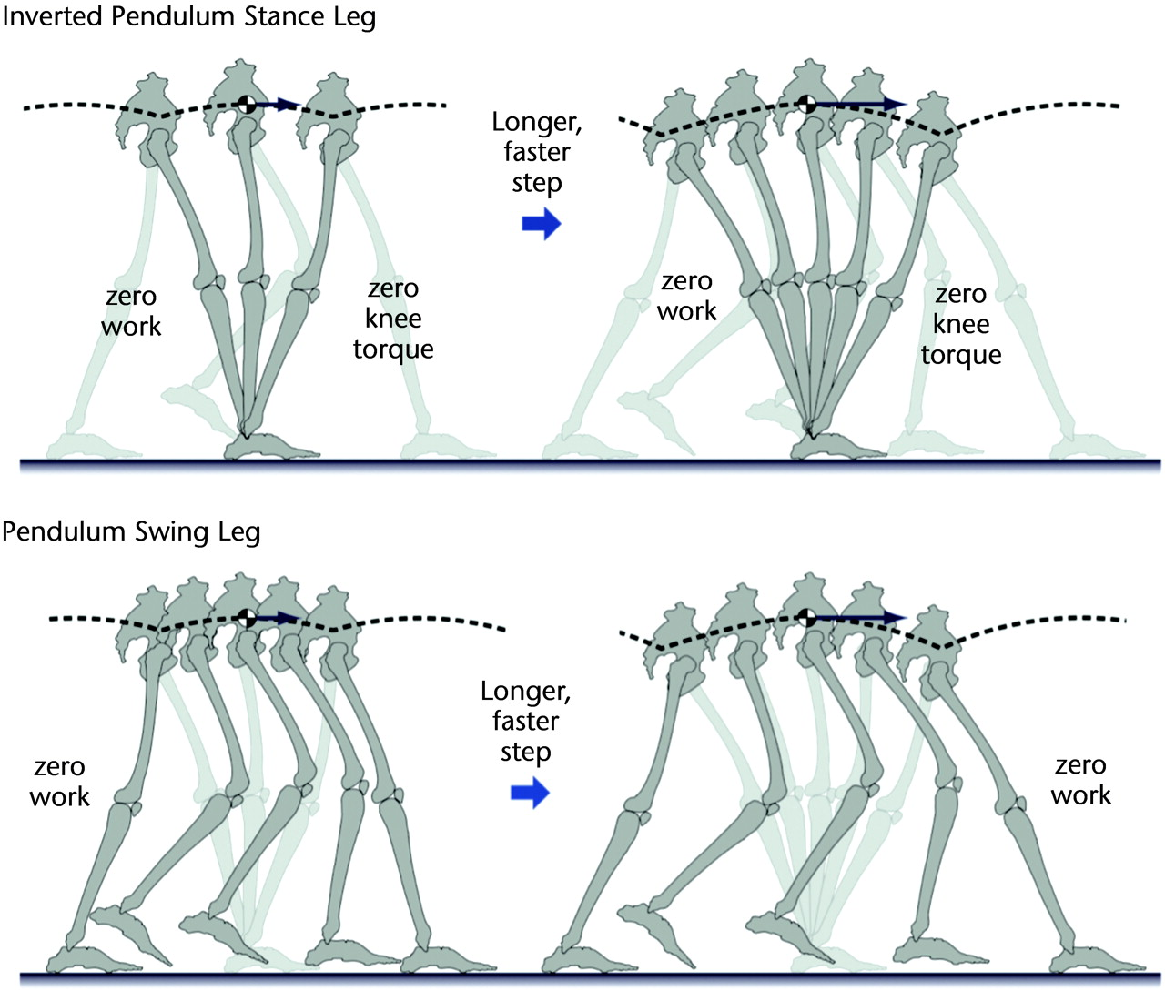

Slide 11
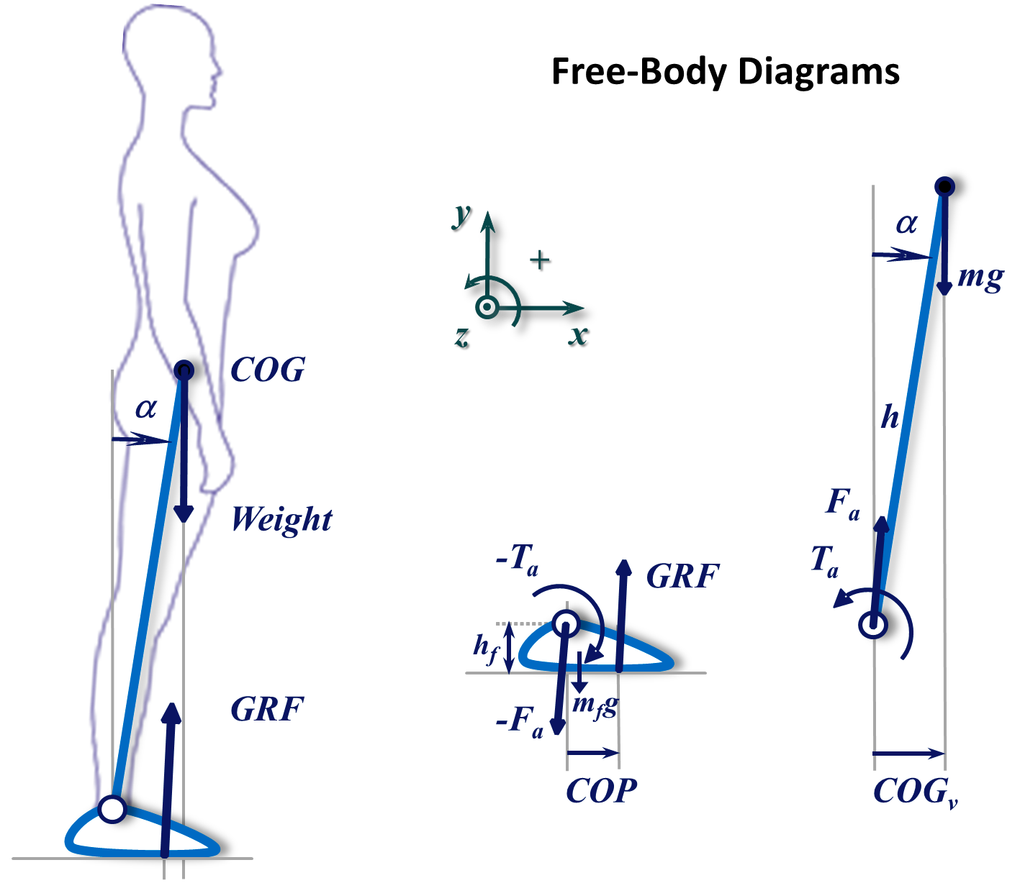
Stance phase of walking
Stance phase, inverted pendulum: key task = postural control
An inverted pendulum is unstable… need balance
Motor control to avoid falling

Slide 12
Swing phase of walking
Pendulum dynamics.
Swing frequency is independent of mass or swing amplitude (for small swing amplitudes).
Therefore, for a human walker, the preferred frequency of walking only depends on one’s leg length.
Notes:
1 rad = 57deg

Slide 13
Stability and energy consumption in walking
When walking at the preferred speed (swing frequency, which depends on one’s leg length),
(1) which phase is less stable?
(2) which phase takes more energy?
(3) which is the active phase and which is the passive phase, in terms of movement control?

Slide 14

Practice
When you are wearing an extremely heavy backpack, the way you walk will look different. Why?
In this case, which phase of walking is more likely to be affected? Why?
Notes:
Stance phase
Center of mass is shifted… need extra control to maintain the center of mass

Slide 15
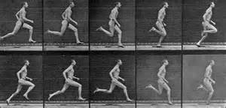
The dynamics of running
Stance phase
Swing phase
The difference between walking and running is whether there is a flight between stance and swing.

Slide 16
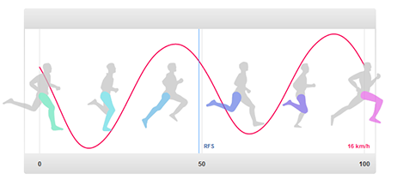
Swing phase of running
Pendulum dynamics.
Passive, not much energy needed, no explicit control.
Frequency of swing is increased by bending the legs (reducing L).

Slide 17
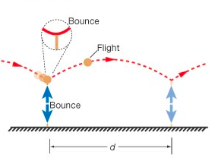
Stance phase of running
Not only involves postural control (not to fall), but also pumping in energy for “flight”.
Flight – the period of running when both legs are in the air.
Dynamics in this phase is like that of a bouncing ball. It comprises elastic compression (= mass spring) and projectile motion.

Slide 18
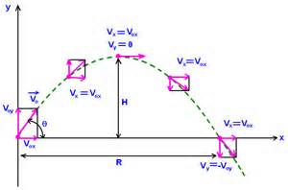
Bouncing ball dynamics: Elastic compression and projectile motion.

Slide 19
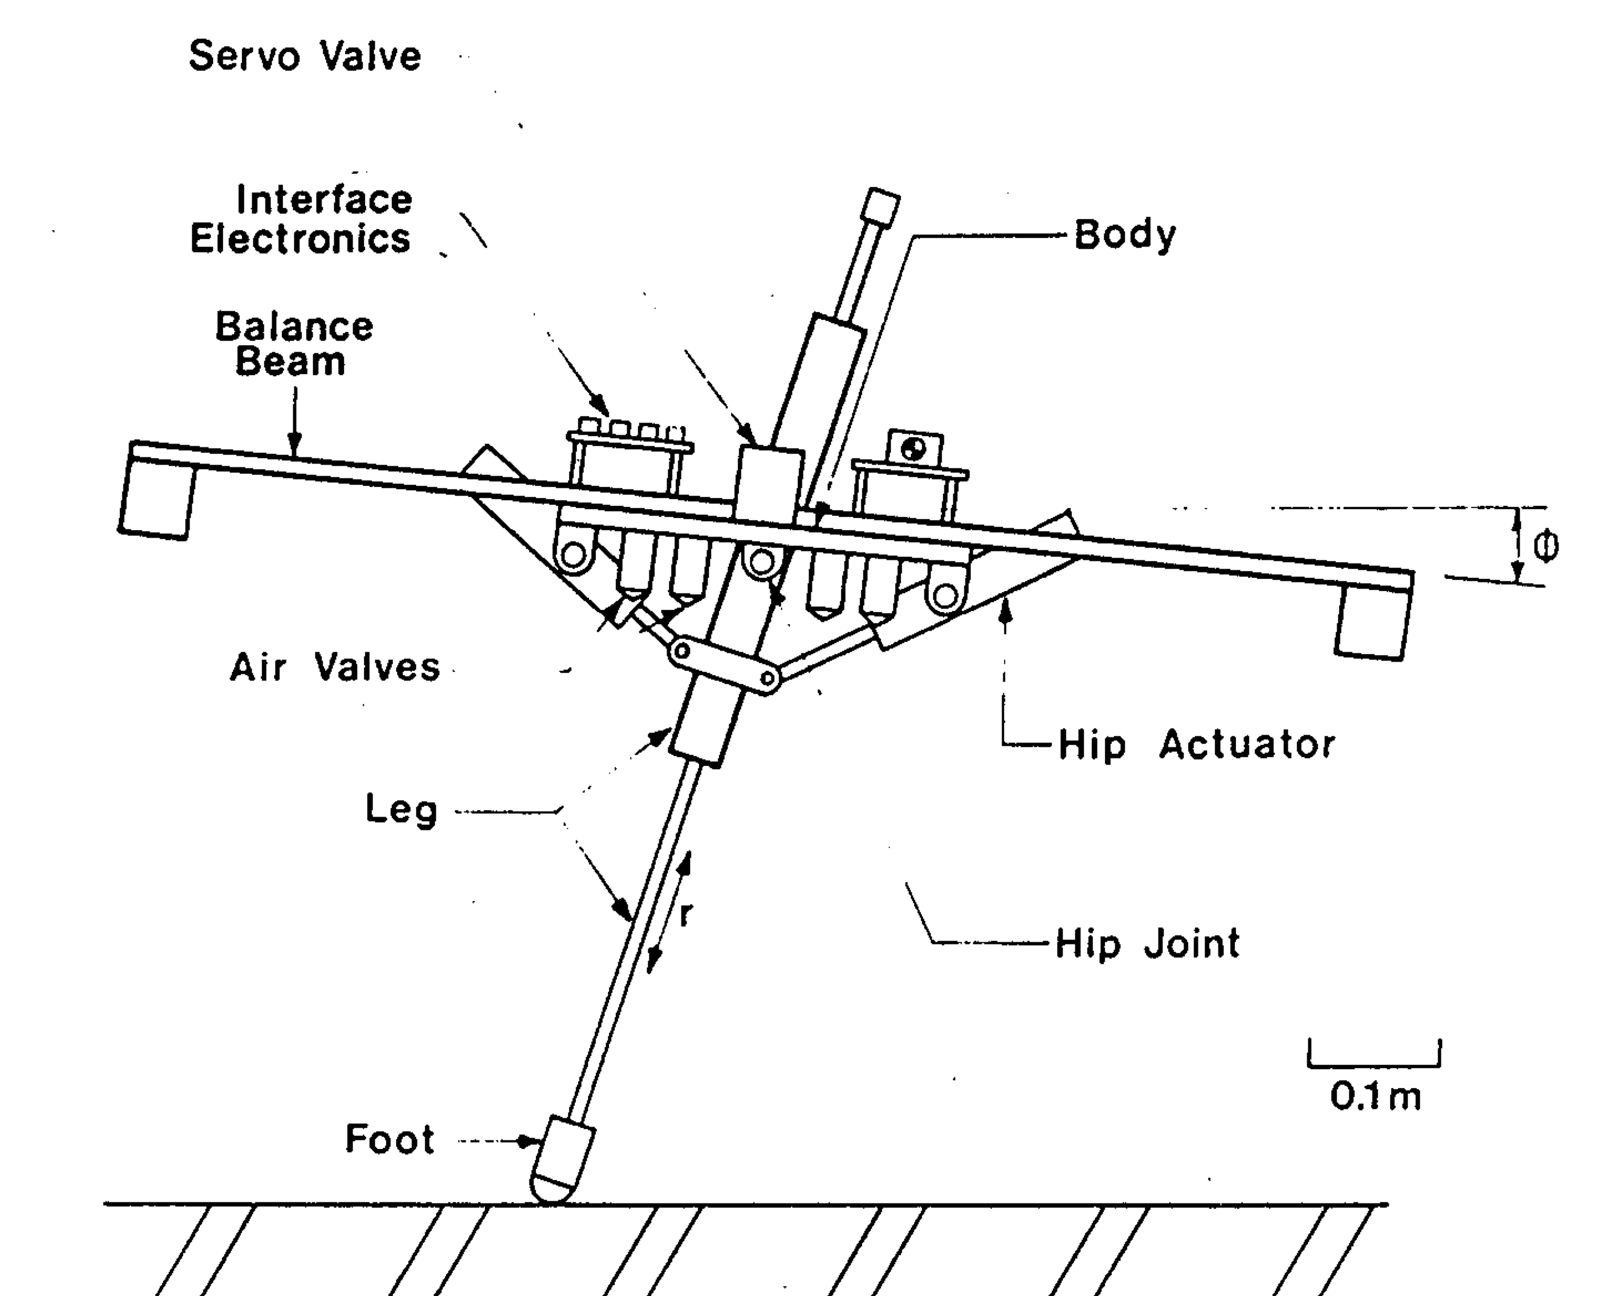
Back to Raibert’s robot (1986)
Human running dynamics: mass spring & projectile motion
Raibert’s hopping robot has only one leg, hence no swing phase
Advantages:
Reduction of explicit control
Stability
Efficient energy use
Movement control is parasitic on underlying dynamics
No need to control for positioning, timing and other kinematics. The dynamics take care of itself.
Notes:
Raibert believed that details of movement form and timing are from the co-opted dynamics of running, which consists of mass-spring motion and projectile motion like pogo sticks. So he let the dynamics take care of its own timing and movement forms. Hence, Raibert’s robots are more efficient in terms of resource usage, specifically: it reduces the explicit control responsibility (that is to control every df as a function of time) needed; dynamics of controlled device are intrinsic to control structure; it increases stability and makes energy usage more efficient.
So he made a robot like a bouncing ball and manipulated parts of it. He added perceptual parts to make adjustment by sensing timing, form of event etc.. The sensor tells you where you are in the dynanics and detects abstract spatial temporal form.
Traditional approach involves explicit control imposed on the dynamics (ignoring the intrisic dynamics of the robot.
16(b) Raibert’s control structure of running is a finite state machine that is parasitic on underlying dynamic and yields intrinsic measure of time via landmarks in movement form, for example, endpoints, transitions etc.. Raibert used linear approximations of complex dynamics to control robots’ moving.
16(c) The three parts are: hopping, forward speed and posture.
During hopping, there is need to control the amplitude by controlling the vertical thrust, as well as to control oscillation, which involves the mass of the robot, stiffness and gravity. It is also needed to pump in energy to recover that lost during hopping.
To control forward speed, speed of movement and limb dynamics are needed.
To control posture, it needs to stabilize pitch angle by torque at hip with traction.

Slide 20
Quadruped locomotion and bifurcation
For efficient energy use

Slide 21
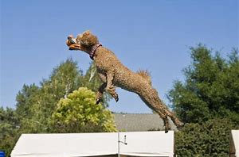
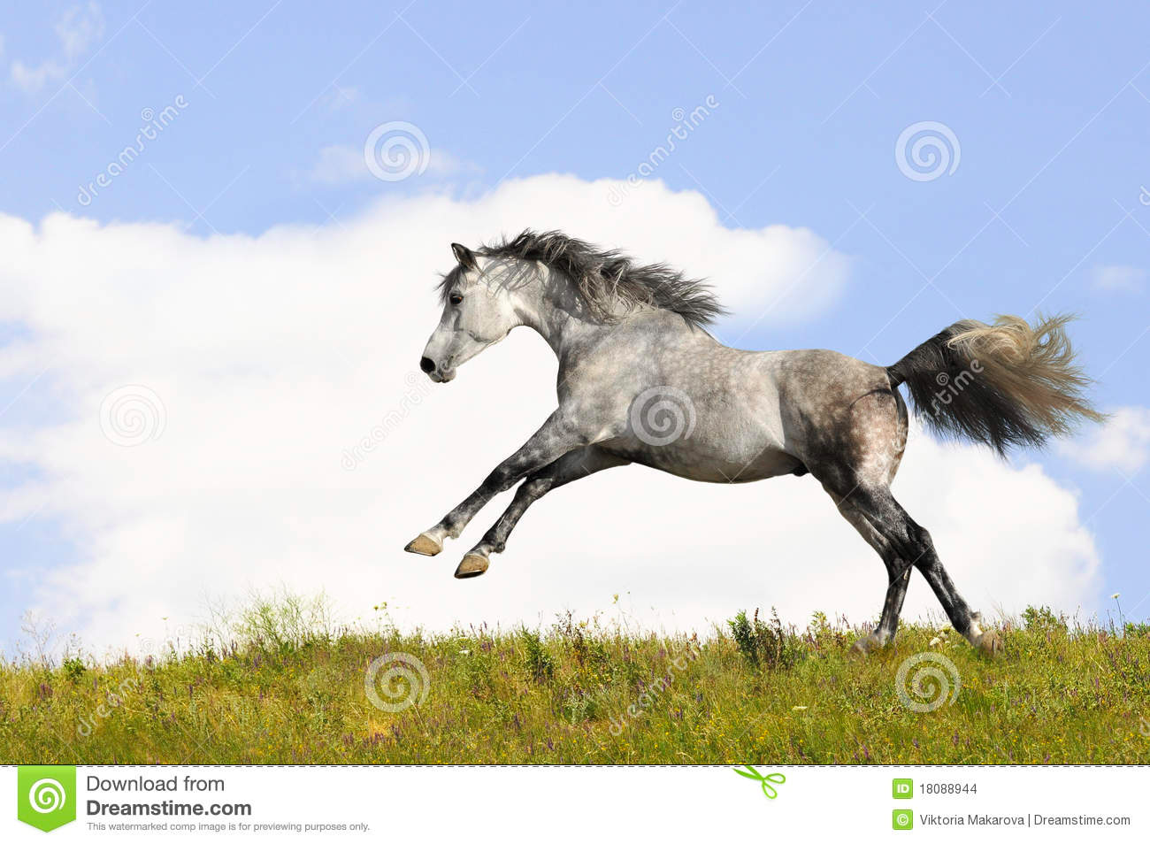
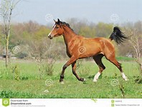
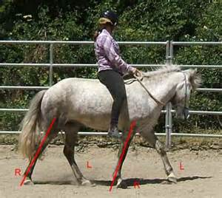
Gate transition in quadrupeds
jump
gallop
trot
pace

Slide 22
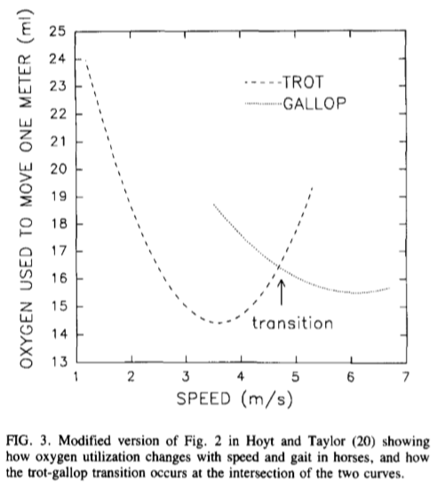
Control variable for gait transition
From an evolutionary perspective: a particular movement pattern is adopted naturally to maximize energy efficiency.
Gait transition for saving energy. Gait patterns bifurcate as locomotion speed increases.
Optimal speed for gallop
trot
gallop
Optimal speed for trotting
Vilensky et al, (1991)

Slide 23
Human walking & running?
Humans also have preferred walking speeds (which vary from individual to individual), at which walking consumes the least amount of energy.
How to you measure energy consumption? Think of Warren’s stair climbing experiments (Warren, 1984).
What naturally happens, when you walk super super fast?
Notes:
When you are really tired but you still have 1000m to run in your race, would you rather run at higher stepping frequency or would you rather increase each step length to save energy?

Slide 24
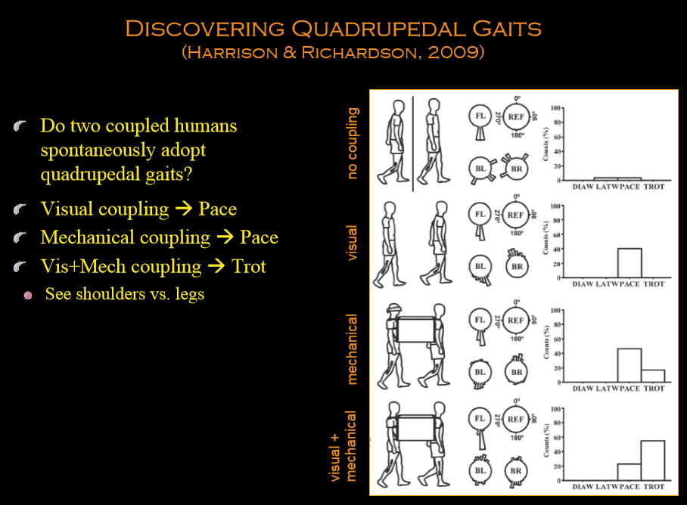

Slide 25
The control law for moving over irregular terrains -- a case study for perception guided action

Slide 26
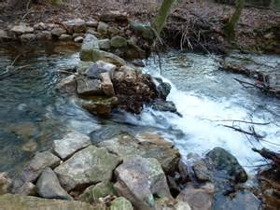
From movement dynamics to locomotion over irregular terrain
Using dynamics to generate a forms of behavior (like running) and then control it (which requires perception).
“How can I control the length of my step?”
Especially important when
locomoting over irregular terrain

Slide 27
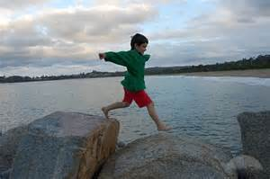
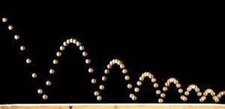
Visually guided running over irregular terrain
Rock 1
Rock 2
Bouncing ball dynamics: What do you need to control so that the ball lands on Rocks 1 and 2?

Slide 28
Warren’s control law for running over irregular terrain
The control law: I = mg Δτ
What is the runner controlling for this task? The impulse.
For an embodied runner, weight is given.
He only needs to detect τ (or to perceive the TTCs) to control for his running.
This is a good example of
Perception-action coupling
Embodied P/A
Higher-order control (coordination and reduction of DF)

Slide 29
Summary
Human walking: swing phase = pendulum dynamics; stance phase = inverted pendulum dynamics
Human running: swing phase = pendulum; stance = bouncing ball dynamics (elastic compression/mass spring + projectile motion during flight)
Horse gait transition to save energy – evolutionary advantage.
The control of locomotion over irregular terrain: I = mg Δτ
Raibert’s approach to building locomoting robots – why do they look so animal-like?

Slide 30
Reading
Warren, Young & Lee (1986): Running over irregular terrain.
Raibert (1986): Legged robots that balance – Ch 1

